Slide 1

RISK ANALYSIS AND ASSESSMENT
Team: ATTAC
Akanksha Singh (21111005)
Gajender Sharma (21111028)
Gargi Sarkar (21111263)
Manu Shukla (21111040)
Shiv Kumar Yadav (21111057)
Mentor – Prof. Dr. Sandeep Kumar Shukla
TA - Venkata Sai Charan Putrevu

Slide 2
Introduction: What is Risk Assessment
Risk assessment is the process of determining the likelihood of threats being used against the vulnerabilities present in a system component and drawing conclusions about the resulting impact when a successful compromise occurs. The classical risk equation for risk assessment is given by:
RISK= Threat * Vulnerability * Consequence
RISK= Likelihood * Consequence
Identify relevant threats to organization.
Identify external and internal vulnerabilities.
Measure impact/harm done by threat.

Slide 3

Why do we need Risk assessment ?
The overall aim of risk assessment is to identify , classify and prioritize the organization’s information assets and based on the importance as well as organization’s fund, doing a trade off in securing them !
Overall, It provides a foundation for developing policies and selecting cost-effective techniques for putting those policies into action in order to protect the system from cyber attacks.

Slide 4
Goals
Get asset details from user.
01
Query the NVD for Potential Vulnerabilities in assets.
02
Get threat dimensions.
03
Allow user to enter severity of vulnerability.
04
Compute risk assessment matrix.
05

Slide 5
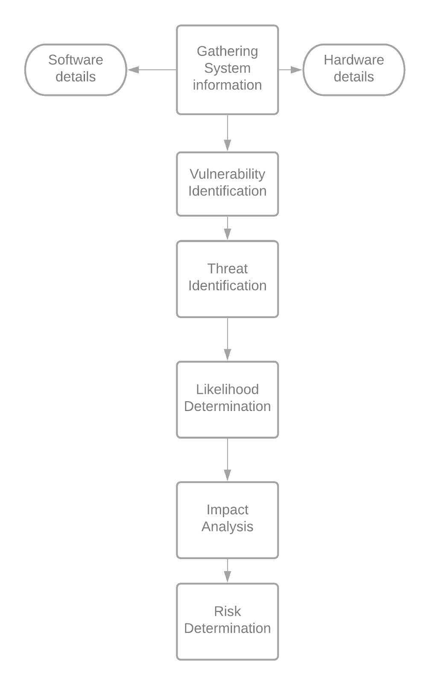
Risk assessment Flow of tasks

Slide 6
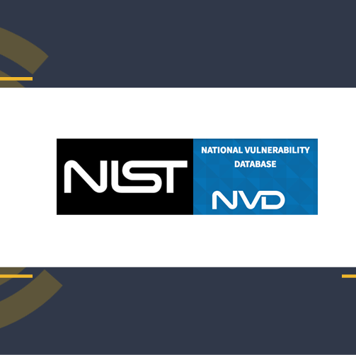
Methodology
NIST Guide to conduct the risk Assessment.
Step 1 (Preparing for the Assessment): Derive the necessary data from the organizational risk frame.
Step 2(Conducting the assessment):
Identify vulnerabilities and predisposing condition.
Identify threat sources and events.
Determining the likelihood of occurrence.
Determine magnitude of impact
Determining risk.

Slide 7
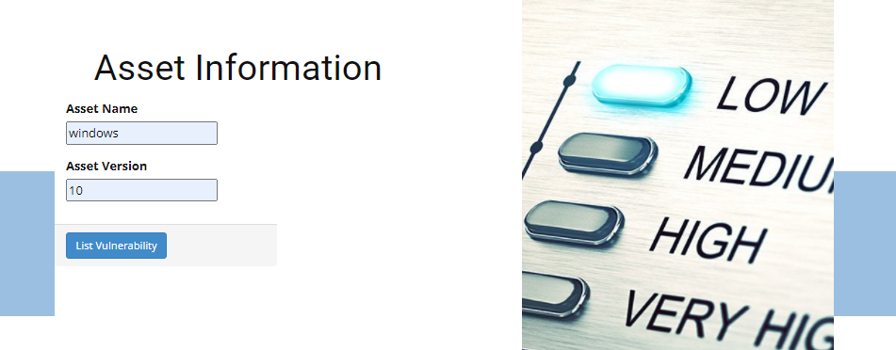
Methodology Step 1 :
Acquiring Details of the organization system’s Hardware and Software details.

Slide 8
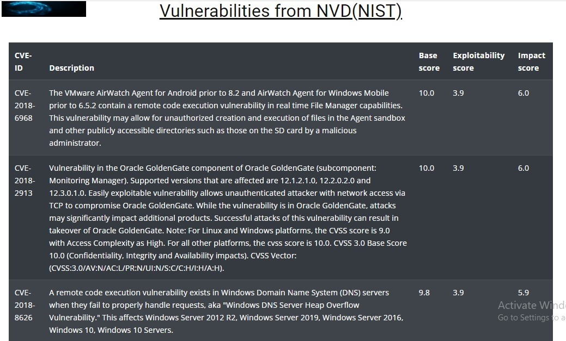
Methodology Step 2 :
Part 1 : Identifying the vulnerabilities based on details provided by the User Through NVD(national vulnerability database) API.

Slide 9
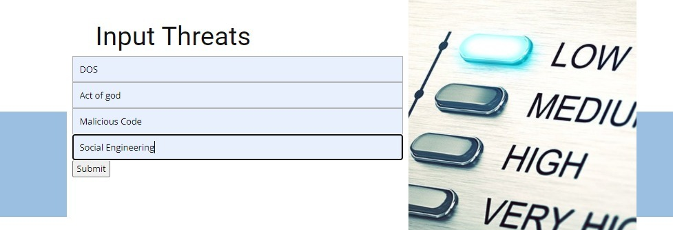
Methodology Step 2 :
Part 2: Input Potential threat sources and events.

Slide 10
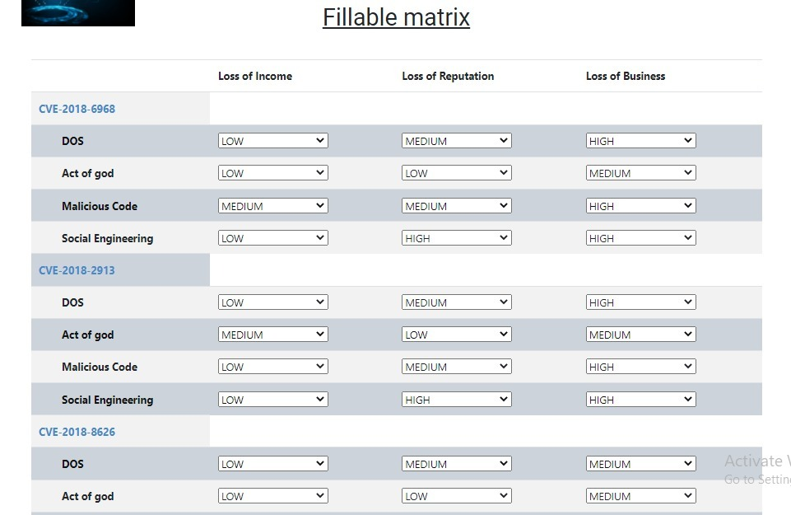
Methodology Step 2 :
Part 3: Determining the likelihood of occurrence.

Slide 11
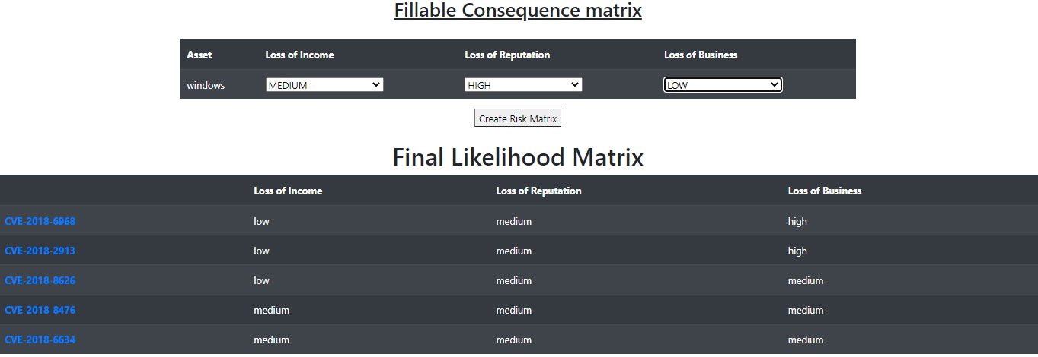
Methodology Step 2 :
Part 4: Determine magnitude of impact

Slide 12
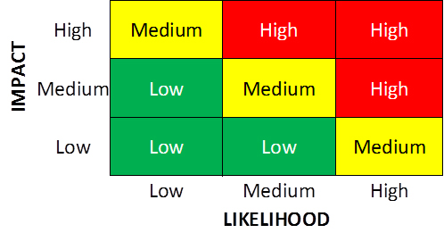
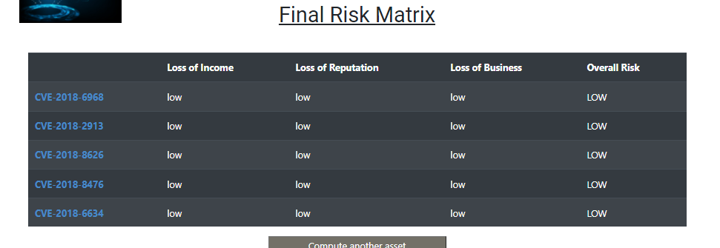
Methodology Step 2 :
Part 5: Determining risk.

Slide 13

Demo Video
Add link here

Slide 14
Challenges
Accessing the NIST-NVD api.
Shortening of vulnerability information, yet retaining important information.
Django project development.
Easy to use interface, dynamic computation.

Slide 15
Future Scope
Multiple assets in one matrix.
Risk analysis for complex OT(ICS, Scada, DCS) systems.
Analysis from network diagrams.
Multiple flavours to search vulnerabilities.

Slide 16


Contribution | Akanksha Singh | Gajender Sharma | Gargi Sarkar | Manu Shukla | Shiv Kumar Yadav
1. NIST-NVD API access
2. UX-UI Design
3. NVD API Integration
4. Likelihood Matrix Creation
5. Impact and Final Likelihood Matrix Creation
6. Final Risk Matrix Creation
7. Final Report
8. Final Presentation

Slide 17

Thankyou
Any feedback?

